Slide 1
FIFA Player Performance Analysis
Data-Driven Insights for Player Evaluation

Slide 2
Project Overview
- Analyzed dataset of 18207 players
- Examined player attributes, values, and performance metrics
- Identified key patterns and clusters
- Developed actionable insights for player evaluation

Slide 3
Key Findings
1. Player values are highly right-skewed
2. 5 distinct player clusters identified
3. Potential peaks at age 20-22
4. Top clubs dominate in both quality and value
5. Different positions have distinct attribute profiles

Slide 4
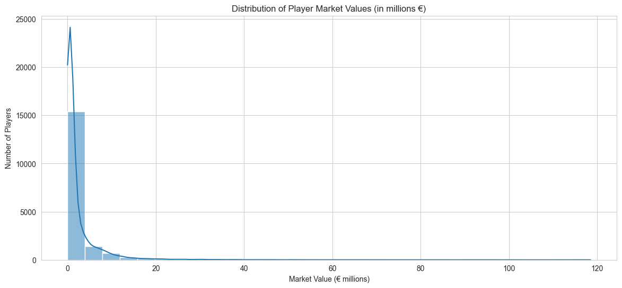
Player Value Distribution

Slide 5
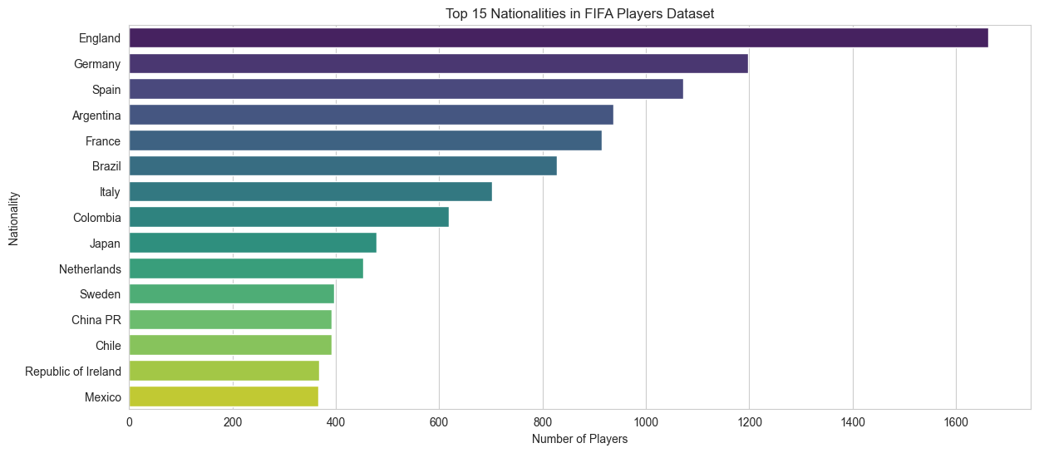
Top Nationalities

Slide 6
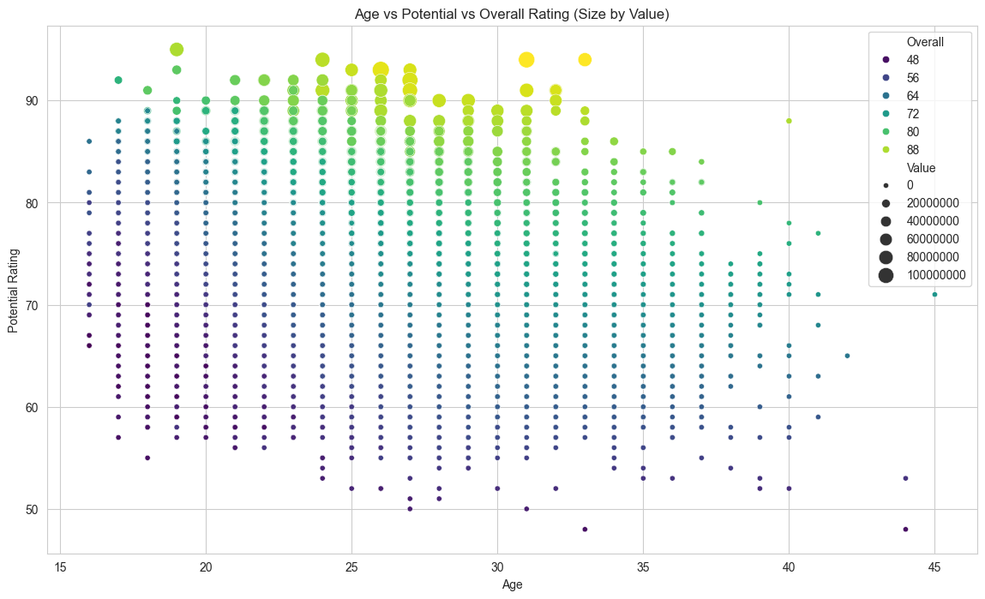
Age vs Potential Analysis

Slide 7
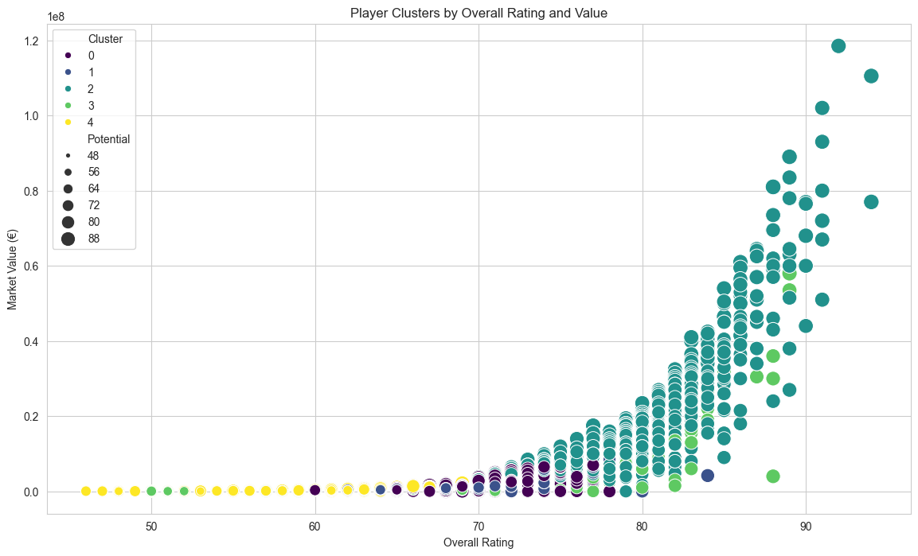
Player Clusters

Slide 8
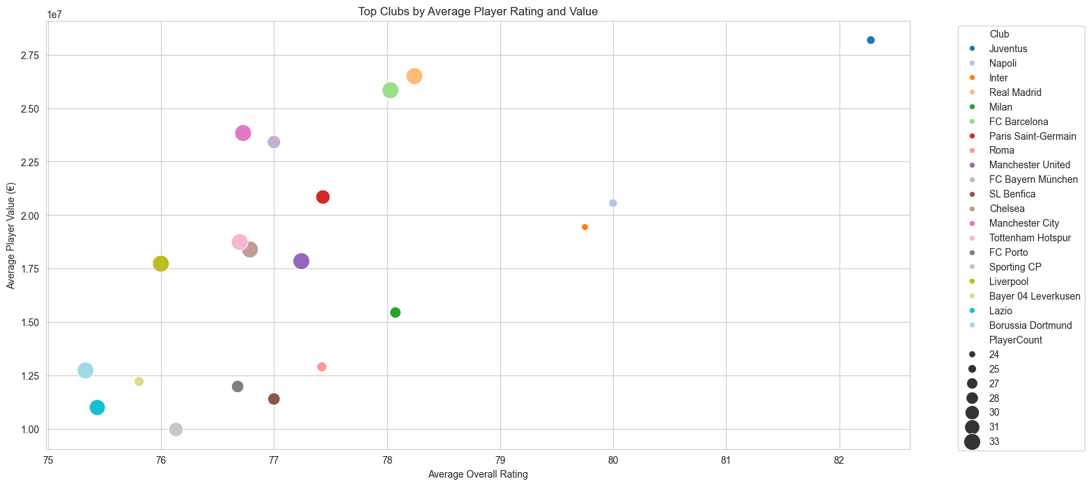
Top Clubs Analysis

Slide 9
Recommendations
1. Focus scouting on players aged 20-25 with high potential
2. Consider cluster-specific training programs
3. Value for money can be found in certain nationality markets
4. Balance squad with both technical and physical players
5. Monitor player development curves carefully

